Slide 1
American Express Campus Analyze This 2016
DETAILED SUBMISSION REPORT

Slide 2
Team Details
Team Name : StockUp **Public lb : 7th
Name | Campus | Roll No. | Mobile No. | Email Id
Abhinav Sharma | IIT Kharagpur | 13IE10030 | 8609276840 | abhinavs01858@gmail.com
Shalvin Kumar Saha | IIT Kharagpur | 13EE10045 | 9775885532 | Shalvin.shalvin@gmail.com

Slide 3
Equation to Identify Citizen’s Vote
LIST OF FEATURES/VARIABLES USED :
Final model is an ensemble of three machine learning algorithms :
Model1 : XGBOOST (eXtreme Gradient Boosting) target ~ all Donations data + all Group and Individual rallies data + all Volunteer data + all fund raisers data (mvar1 to mvar25) + mvar26 + mvar28 + mvar29 + mvar30 + mvar31 + + mvar32 + mvar33 + one hot encoding of Age (mvar27) + var1 + var2 + var3 + var4 + var5 + feature1 + feature2 + feature3 (description given in next slide)
features in bold represent features already present in data
features in bold, italic, underline represent engineered features
*Age variable is one hot encoded, gives a better boost to accuracy, relative to other categorical variables
**All the other categorical variables are label encoded
Model is trained by 55% of data sampled randomly, Individual Score on public lb : 681050

Slide 4
Details of each Variable used in the Equation
FEATURE ENGINEERING
Variables mvar1 to mvar33 used from given data, with proper one hot encoding or label encoding for categorical variables.
Note that variable “Past Voted party” is not included, due to its very high co-relation, 75% of target is same as past vote, thereby causing model to tending to predict past-vote more often then required.
Variable var1 = 0.05 ^ ( k1 / (1 + k1 + k2 + k3 + k4 + k5 ) ) where k1 = 20*mvar1 + 10*mvar6 + 5*mvar11 + 4*mvar16 + 15*mvar21 thus k1 signifies the ‘weighted sum of the entire contribution of a person to a particular party’. Weights are assigned on intuition viz., 20 for donations, 15 for volunteering, 10 for individual rally, 5 for group rallies and 4 for fund-raisers. similarly we have var2, var3, var4, var5 as the exponentials of contributions to a particular party.
**Exponential ensures greater number of levels or the continuity of a variable

Slide 5
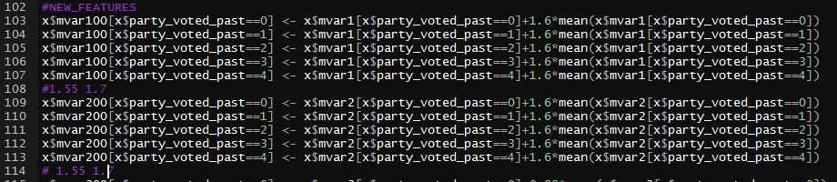
Details of each Variable used in the Equation
FEATURE ENGINEERING
Variable feature1 signifies if the candidate has moved to a different city of stayed in the same. It’s a binary variable with 0 if person hasn’t changed residence area and 1 if he has. *gives a boost of about 2000 on public lb ** based on the hunch that inter-city migrating people will tend not to vote the person who is more popular in his original place of residence.
Variable feature2 : mvar100 = mvar1 + 1.6*(history based party-wise mean of mvar1)
Variable feature3 : mvar200 = mvar2 + 1.6*(history based party-wise mean of mvar2) Snippet in R :
*feature2 and feature3 giving the maximum information gain **improved version of parameter : how much more than average donation for a particular party, is a person donating.

Slide 6
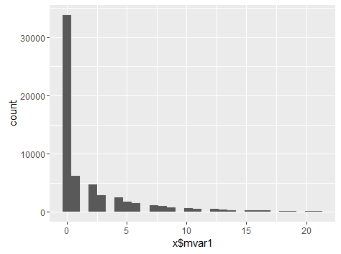
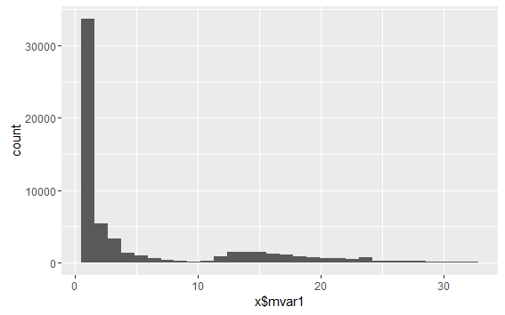
Details of each Variable used in the Equation
FEATURE ENGINEERING
Variable feature2 : Original mvar1 (Donation to Centaur) feature2 = function (mvar1, voting history)
*features giving the maximum information gain **improved version of parameter : how much more than average donation for a particular party, is a person donating.

Slide 7
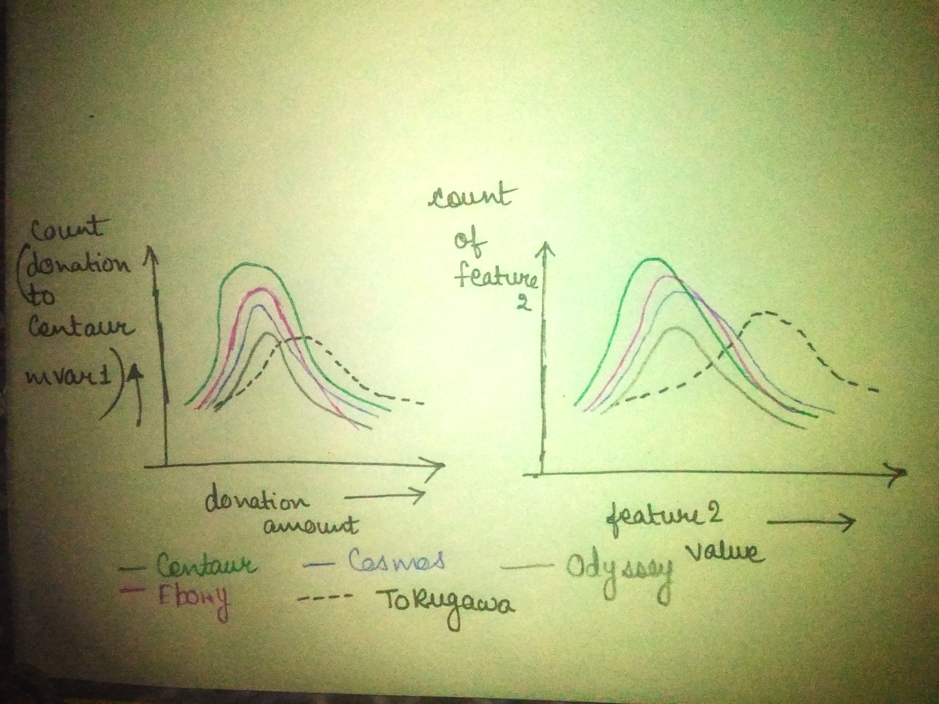
Details of each Variable used in the Equation
FEATURE ENGINEERING
Why maximum information gain from variable feature2 and feature3 :
*features giving the maximum information gain **improved version of parameter : how much more than average donation for a particular party, is a person donating.

Slide 8
Equation to Identify Citizen’s Vote
Please provide the final equation used to identify the citizen’s vote
Final model is an ensemble of three machine learning algorithms :
2. Model2 Multinom (Neural Net)
target ~ Past_Voted + all Donations data + all Group and Individual rallies data + all Volunteer data + all fund raisers data (mvar1 to mvar25) + mvar26 + mvar28 + mvar29 + mvar30 + mvar31 + + mvar32 + mvar33 + one hot encoding of Age (mvar27) + var1 + var2 + var3 + var4 + var5 + feature1 + feature2 + feature3 (description given above)
Multinom is a variation of ANN, from the nnet package in R Since we have over 75% actual output same as past voted party, we use multinom due to its ability to deal with linear data. Thus information gain from voter history is taken into account with least probable overfitting. *Converge multinom a little earlier than it takes for full convergence, ** Used 100% data to train, Individual model score : 658050

Slide 9
Equation to Identify Citizen’s Vote
Please provide the final equation used to identify the citizen’s vote
Final model is an ensemble of three machine learning algorithms :
3. Model3 XGBOOST (eXtreme Gradient Boosting) target ~ Past data + all Donations data + all Group rallies data + mvar26 + mvar28 + mvar29 + mvar30 + mvar31 + + mvar32 + mvar33 + one hot encoding of Age (mvar27) + var1 + var2 + var3 + var4 + var5 + feature1 + feature2 + feature3 (description given above)
This Xgboost is essentially used to predict out the outliers of our data. Data used : All voters whose Past_Vote and Actual_Vote is different, along with a random 1% of the total users, size of training data is approx. 17.66% of entire data.
Role in final solution : Used to substitute outliers, 5% - 8% of predictions, the cases where our predictions are the most uncertain. *Public lb score using ensemble of all three models = 690,000

Slide 10
Estimation Technique Used
Modeling Technique
Model 1 The xgboost model is used to train with parameters, depth =10, min_child_weight = 800, nrounds = 1600, subsample = 0.9 The objective is set to “multi:softprob” to get probabilities of all five candidates being voted by a particular voter. Thus we have a probability table of (nrows in test data x 5 ). We output the candidate having maximum probability.
Model 2 The multinom model uses maxit = 150 to avoid entire convergence. We pass the argument pred = “probs” to avail a vector of length (nrows in test data x 5 ). This vector is converted into probability table 2 of dimensions (nrows in test data x 5 )
Ensembling Probability_table_final = 0.6*Probability_table1 + 0.4* Probability_table2 The probability table from both these models is used to get final predictions. We output the candidate having maximum probability in Probability_table_final.
Outlier Substitution (a) Highest amongst the 5 probabilities, one for each candidate (b) Second Highest amongst the 5 probabilities, one for each candidate
We substitute those final predictions, where (a)-(b) < 0.1 by prediction from model3. *roughly 5% of the final predictions are substituted

Slide 11
Reasons for Technique(s) Used
Why do you think this is the best technique(s) for this particular problem?
Even though there are many multi-class classification models more commonly used than xgboost, the ability to obtain the probabilities for every possible consequence is a great plus of both the xgb and neural net approaches. Besides, generating a continuous feature from the data, makes predictions more accurate for xgboost. Also, Neural nets readily search for hidden features amongst the data given, and multinom deals with higher correlation variables without over-fitting. An ensemble of both these techniques, that are using different methods to boost up the accuracy, ensures a more robust prediction model.

Slide 12
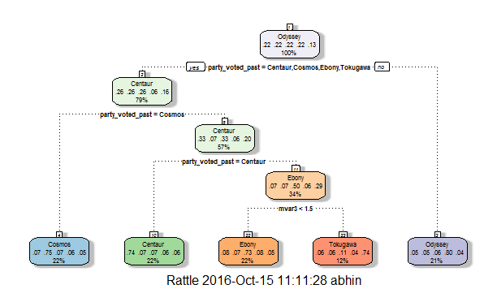
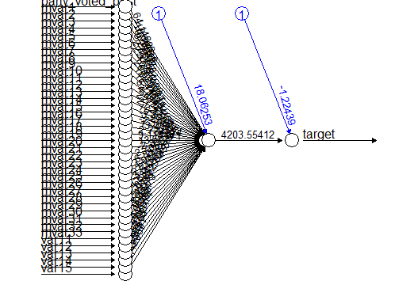
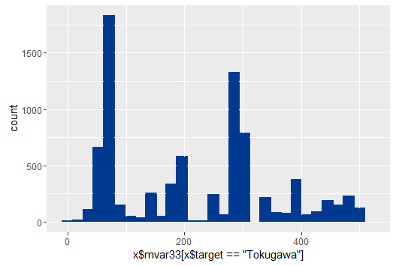
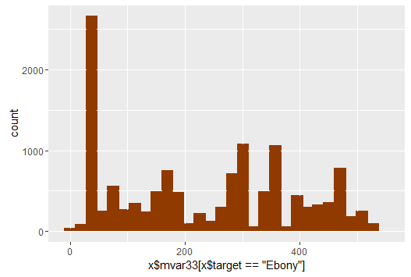
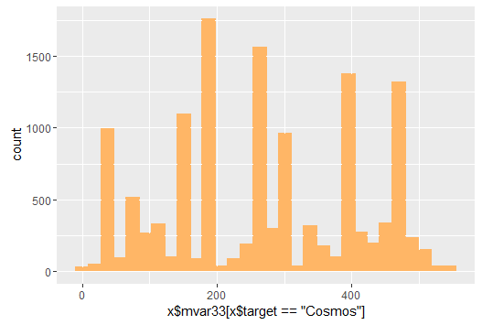
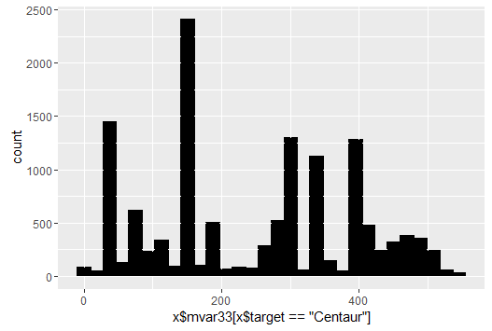
Estimation Technique Tried
Other Modeling Techniques tested
Decision Trees (~560,000)
Random Forest (~630,000)
Support Vector Machine
K Nearest Neighbours (~630,000) at k = 5.
Naive Bayes Algorithm
Features that could prove useful
The location feature couldn’t be tapped to its ful potential and has a lot of scope to engineer newer features that enhance accuracy of the prediction further.

Slide 13
Final Submission File
Please embed your final submission file (.csv) here.

